Slide 1
SQL Functions – Handling NULL values, numbers and dates Dr Mariana Rocha School of Computer Science
CPMU 2007 Databases 1, Lecture 5

Slide 2
Single-row functions
Character
Accept character input
Returns a single value
Can return both character and numeric values
Handle NULL values or selection of return value based on choices
General
Single-row
functions
Number
Accepts numeric input
Returns a single numeric value
\
Conversion
Date
Convert a value from one data type to another
Operate on date data type
Returns a value of date data type
Notes:
Single-Row Functions (continued)
This lesson covers the following single-row functions:
Character functions: Αccept character input and can return both character and number values
Number functions: Accept numeric input and return numeric values
Date functions: Operate on values of the DATE data type (All date functions return a value of DATE data type except the MONTHS_BETWEEN function, which returns a number.)
Conversion functions: Convert a value from one data type to another
General functions:
NVL
NVL2
NULLIF
COALESCE
CASE
DECODE

Slide 3
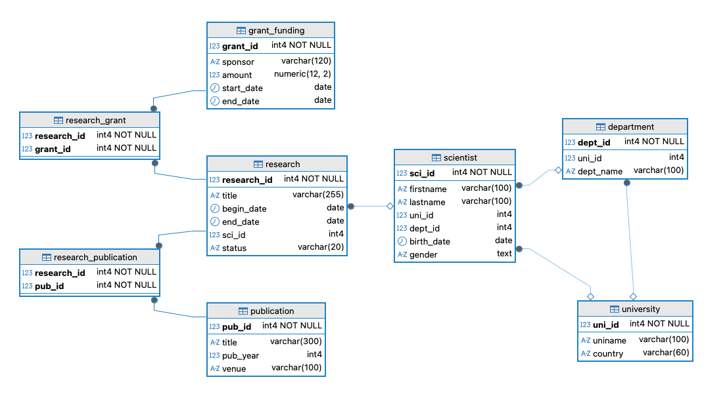
Notes:
Number Functions
Number functions accept numeric input and return numeric values. This section describes some of the number functions.
Note: This list contains only some of the available number functions.
For more information, see “Number Functions” in Oracle SQL Reference.

Slide 4
General functions

Slide 5
nullif(x,y)
NULLIF is a accepts two arguments and returns a NULL if the two arguments are equal. Otherwise, it returns the first argument.
It is useful when we need to replace specific values with NULL.
Suppose we don’t want the user to see SFI as one of the sponsors:
SELECT sponsor, nullif(sponsor, 'SFI') FROM grant_funding;

Slide 6
coalesce( )
Used to handle NULL values in a database query by returning the first non-NULL value from a list of expressions or column values.
It provides a default or fallback value when NULL values are encountered in the data.
Suppose you want to retrieve the scientist’s date of birth and replace it with their firstname in case the value is null:
SELECT coalesce(birth_date::text,firstname) FROM scientist;

Slide 7
greatest( )
Returns the greatest value among a list of values.
Suppose you want to know which one is the most recent: the project end_date or today’s date.
SELECT research_id, title, GREATEST(end_date, CURRENT_DATE) "Most recent date" FROM research;

Slide 8
least( )
Opposite of greatest( ): returns the smallest value among a list of values.
Suppose you want to know which one is the oldest: the project end_date or today’s date.
SELECT research_id, title, LEAST(end_date, CURRENT_DATE) "Most recent date" FROM research;

Slide 9
Number functions

Slide 10
Number Functions
ROUND: Rounds value (up) to specified decimal
TRUNC: Truncates value to specified decimal
MOD: Returns the remainder of the division
Function | Result
ROUND(45.926, 2) | 45.93
TRUNC(45.926, 2) | 45.92
MOD(15,4) | 3
Notes:
Number Functions
Number functions accept numeric input and return numeric values. This section describes some of the number functions.
Note: This list contains only some of the available number functions.
For more information, see “Number Functions” in Oracle SQL Reference.

Slide 11
Number Functions
--Round
SELECT grant_id, amount, ROUND(amount, 1) "Rounded amount" FROM grant_funding; --we could also do round(amount)for no decimal number
We can also use ceil( ) [round up to the nearest integer] and floor( ) [round down to the nearest integer]
--Ceil, floor and round
SELECT grant_id, amount, ROUND(amount) "Round", ceil(amount) "Round up", floor(amount) "Round down" FROM grant_funding;
Notes:
Number Functions
Number functions accept numeric input and return numeric values. This section describes some of the number functions.
Note: This list contains only some of the available number functions.
For more information, see “Number Functions” in Oracle SQL Reference.

Slide 12
Using the ROUND Function
SELECT ROUND(450.9234), ROUND(450.9234,-1)/*nearest 10s*/, ROUND(450.9234,-2)/*nearest 100s*/, ROUND(450.9234,-3)//*nearest 1000s*/;
Negative second argument indicates rounding to the left of the decimal point
Using -1 as the second argument in the function round( ) means you aim to round to the nearest 10s (up or down); using -2, to the nearest 100s; using -3, to the nearest 1000s etc.
Notes:
ROUND Function
The ROUND function rounds the column, expression, or value to n decimal places. If the second argument is 0 or is missing, the value is rounded to zero decimal places. If the second argument is 2, the value is rounded to two decimal places. Conversely, if the second argument is –2, the value is rounded to two decimal places to the left (rounded to the nearest unit of 10).
The ROUND function can also be used with date functions. You will see examples later in this lesson.
DUAL Table
The DUAL table is owned by the user SYS and can be accessed by all users. It contains one column, DUMMY, and one row with the value X. The DUAL table is useful when you want to return a value once only (for example, the value of a constant, pseudocolumn, or expression that is not derived from a table with user data). The DUAL table is generally used for SELECT clause syntax completeness, because both SELECT and FROM clauses are mandatory, and several calculations do not need to select from actual tables.

Slide 13
Using the TRUNC Function
Truncate works similarly, but without rounding the number.
The decimal numbers are dropped, and the number on the left is truncated to 0 if the argument is -1, to 00 if the argument is -2, etc.
With negative second argument, TRUNC will make value zero to left of decimal point, so 45 becomes 40
--Truncate
SELECT TRUNC(450.923, -1)/*truncate to nearest 10s*/,
TRUNC(450.923,-2), TRUNC(450.923,-3) /*truncate to nearest 100s*/;
Notes:
TRUNC Function
The TRUNC function truncates the column, expression, or value to n decimal places.
The TRUNC function works with arguments similar to those of the ROUND function. If the second argument is 0 or is missing, the value is truncated to zero decimal places. If the second argument is 2, the value is truncated to two decimal places. Conversely, if the second argument is –2, the value is truncated to two decimal places to the left. If the second argument is –1, the value is truncated to one decimal place to the left.
Like the ROUND function, the TRUNC function can be used with date functions.

Slide 14
Using the TRUNC Function
In finance, truncate( ) can be useful to discard insignificant decimal places to avoid rounding that could affect the balance, inflating or deflating amounts.
We can also use it when a system operates on strict thresholds. Suppose an app operates with fixed resource limits on the database – truncating can ensure that the resource count remains within bounds without rounding up.
Notes:
TRUNC Function
The TRUNC function truncates the column, expression, or value to n decimal places.
The TRUNC function works with arguments similar to those of the ROUND function. If the second argument is 0 or is missing, the value is truncated to zero decimal places. If the second argument is 2, the value is truncated to two decimal places. Conversely, if the second argument is –2, the value is truncated to two decimal places to the left. If the second argument is –1, the value is truncated to one decimal place to the left.
Like the ROUND function, the TRUNC function can be used with date functions.

Slide 15
Mod
MOD: Returns the remainder of the division.
Used for detecting even/odd patterns
Helps to categorise based on numerical patterns
Notes:
Number Functions
Number functions accept numeric input and return numeric values. This section describes some of the number functions.
Note: This list contains only some of the available number functions.
For more information, see “Number Functions” in Oracle SQL Reference.

Slide 16
Mod
Suppose the university regularly reviews new research projects, and each project must be assigned to one of 3 review committees:
Instead of manually distributing projects, you want a quick automatic rule that balances the load evenly among committees.
We can use the mod of the research_id to allocate the projects to each committee.
Committee ID | Description
0 | Ethics & Compliance
1 | Methodology Review
2 | Funding Allocation
Notes:
Number Functions
Number functions accept numeric input and return numeric values. This section describes some of the number functions.
Note: This list contains only some of the available number functions.
For more information, see “Number Functions” in Oracle SQL Reference.

Slide 17
Mod
Committee ID | Description
0 | Ethics & Compliance
1 | Methodology Review
2 | Funding Allocation
SELECT
research_id,
title,
MOD(research_id, 3) "Assigned committee"
FROM research r
ORDER BY 3;
Notes:
Number Functions
Number functions accept numeric input and return numeric values. This section describes some of the number functions.
Note: This list contains only some of the available number functions.
For more information, see “Number Functions” in Oracle SQL Reference.

Slide 18
abs( )
The absolute( ) function returns the absolute value of a number, even if it is a negative one.
For example, suppose we want to see if there is a difference between the end date of the research project and the end date of the funding. We don’t want any negative values, though.
--abs( ): Suppose we want to know the difference in days between the end of the research and the end of grant. We do not want negative values, though
SELECT r.end_date "Research ends", g.end_date "Grant ends", abs(g.end_date - r.end_date) "Days variance" FROM research r JOIN research_grant rg USING (research_id) JOIN grant_funding g USING (grant_id);
Notes:
SYSDATE Function
SYSDATE is a date function that returns the current database server date and time. You can use SYSDATE just as you would use any other column name. For example, you can display the current date by selecting SYSDATE from a table. It is customary to select SYSDATE from a dummy table called DUAL.
Example
Display the current date using the DUAL table.
SELECT SYSDATE FROM DUAL;

Slide 19
Working with Dates - formatting
The function to_char can be used to display data in a certain format
SELECT birth_date, to_char(birth_date, 'DD/MM/YYYY') FROM scientist;
Notes:
SYSDATE Function
SYSDATE is a date function that returns the current database server date and time. You can use SYSDATE just as you would use any other column name. For example, you can display the current date by selecting SYSDATE from a table. It is customary to select SYSDATE from a dummy table called DUAL.
Example
Display the current date using the DUAL table.
SELECT SYSDATE FROM DUAL;

Slide 20
Working with Dates – current time
The now( ) function can retrieve the current date and time. It is given as a timestamp data type.
--current time
SELECT now();
SELECT current_date;
--current time data type
SELECT pg_typeof(now());
Notes:
SYSDATE Function
SYSDATE is a date function that returns the current database server date and time. You can use SYSDATE just as you would use any other column name. For example, you can display the current date by selecting SYSDATE from a table. It is customary to select SYSDATE from a dummy table called DUAL.
Example
Display the current date using the DUAL table.
SELECT SYSDATE FROM DUAL;

Slide 21
Arithmetic with Dates
Adding seven (7) to a value stored in a date column produces a date that is one week later than the stored date.
To calculate the duration of a project in weeks, we can divide the number of days by 7.
--date in a week from now
SELECT current_date + 7;
--project duration in weeks
SELECT (end_date - begin_date) / 7 from research;
Notes:
Arithmetic with Dates
Because the database stores dates as numbers, you can perform calculations using arithmetic operators such as addition and subtraction. You can add and subtract number constants as well as dates.
You can perform the following operations:

Slide 22
Arithmetic with Dates
We can also calculate the difference between the current date and a specific value using the function age( )
--calculate scientist's age
SELECT age(birth_date) FROM scientist;
--calculate projects's age
SELECT age(begin_date) FROM research;
Notes:
Arithmetic with Dates
Because the database stores dates as numbers, you can perform calculations using arithmetic operators such as addition and subtraction. You can add and subtract number constants as well as dates.
You can perform the following operations:

Slide 23
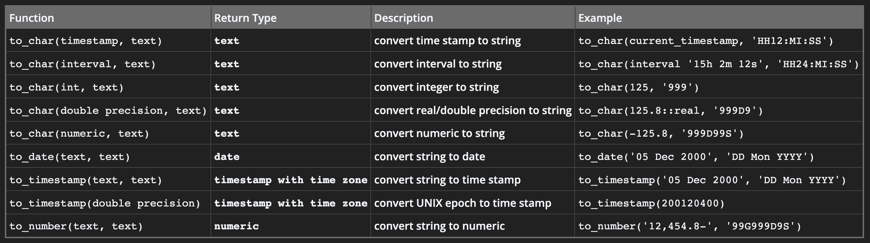
Conversion Functions
Notes:
Conversion Functions
In addition to Oracle data types, columns of tables in an Oracle database can be defined using ANSI, DB2, and SQL/DS data types. However, the Oracle server internally converts such data types to Oracle data types.
In some cases, the Oracle server uses data of one data type where it expects data of a different data type. When this happens, the Oracle server can automatically convert the data to the expected data type. This data type conversion can be done implicitly by the Oracle server or explicitly by the user.
Implicit data type conversions work according to the rules that are explained in the next two slides.
Explicit data type conversions are done by using the conversion functions. Conversion functions convert a value from one data type to another. Generally, the form of the function names follows the convention data type TO data type. The first data type is the input data type; the second data type is the output.
Note: Although implicit data type conversion is available, it is recommended that you do explicit data type conversion to ensure the reliability of your SQL statements.

Slide 24
Cast( )
The function cast(attribute AS data type) is used to convert values into other data types for processing.
The double colon syntax is a shorthand to cast values.
SELECT pg_typeof(cast(begin_date AS TEXT)) FROM research;
SELECT pg_typeof(amount::text) FROM grant_funding;
Notes:
Arithmetic with Dates
Because the database stores dates as numbers, you can perform calculations using arithmetic operators such as addition and subtraction. You can add and subtract number constants as well as dates.
You can perform the following operations:

Slide 25
Using the TO_CHAR Function with Dates
In our function, fm stands for fill mode.
Fill mode removes any leading spaces or padding that would normally be added for certain format elements.
In our formula, depth is used to format numbers as spelt-out ordinal words with appropriate suffixes (like "st", "nd", "rd", and "th").
SELECT firstname, TO_CHAR(birth_date, 'fmDD Month YYYY') FROM scientist;
SELECT firstname, TO_CHAR(birth_date, 'Month DDspth') FROM scientist;
Notes:
…

Slide 26
Date Format of to_char
Format | Output
D | Day of week (1-7)
DD | Day of week (1-31)
DAY | Name of day right padded to display blanks up to length of longest day name
MM | Month (1-12)
MON | Abbreviated Month Name
MONTH | Full Month Name
YEAR | Year spelt out
YYYY | 4 digit year
YY | 2 digit year
Suffixes for numbers:
TH e.g DDTH would be perhaps 4TH
SP spelled number DDSP FOUR
SPTH spelled number plus TH FOURTH

Slide 27
Using the TO_CHAR Function with Numbers
TO_CHAR(number, 'format_model') ddspth
These are some of the format elements that you can use with the TO_CHAR function to display a number value as a character:
Element | Result
9 | Represents a number
0 | Forces a zero to be displayed
$ | Places a floating dollar sign
L | Local currency sign
. | Prints a decimal point
, | Prints a comma as thousands indicator
Notes:
Using the TO_CHAR Function with Numbers
When working with number values such as character strings, you should convert those numbers to the character data type using the TO_CHAR function, which translates a value of NUMBER data type to VARCHAR2 data type. This technique is especially useful with concatenation.

Slide 28
Using the TO_CHAR Function with Numbers
--currency sign
SELECT to_char(amount, '€999,999.99') FROM grant_funding;
Notes:
Guidelines
The Oracle server displays a string of number signs (#) in place of a whole number whose digits exceed the number of digits that is provided in the format model.
The Oracle server rounds the stored decimal value to the number of decimal places that is provided in the format model.

Slide 29
Create your own function Procedure language SQL (PL/pgSQL)
Notes:
Guidelines
The Oracle server displays a string of number signs (#) in place of a whole number whose digits exceed the number of digits that is provided in the format model.
The Oracle server rounds the stored decimal value to the number of decimal places that is provided in the format model.

Slide 30
PL/pgSQL (Procedural Language/PostgreSQL) functions allow you to write reusable, modular blocks of code that can perform complex operations not easily achieved with a simple query.
PL/pgSQL functions extend SQL by allowing control structures such as loops and conditional statements.
PL/pgSQL functions are often used as triggers, where a function is executed automatically in response to certain events on a table (like INSERT, UPDATE, or DELETE).
Notes:
Guidelines
The Oracle server displays a string of number signs (#) in place of a whole number whose digits exceed the number of digits that is provided in the format model.
The Oracle server rounds the stored decimal value to the number of decimal places that is provided in the format model.

Slide 31
Syntax
CREATE OR REPLACE FUNCTION function_name(parameter_name data_type)
RETURNS return_type AS $$
BEGIN
RETURN something;
END;
$$ LANGUAGE plpgsql;
Notes:
Guidelines
The Oracle server displays a string of number signs (#) in place of a whole number whose digits exceed the number of digits that is provided in the format model.
The Oracle server rounds the stored decimal value to the number of decimal places that is provided in the format model.

Slide 32
--PL/SQL
CREATE OR REPLACE FUNCTION get_project_status(begin_d DATE, end_d DATE)
RETURNS TEXT AS $$
BEGIN
IF current_date BETWEEN begin_d AND end_d THEN
RETURN 'Active';
ELSEIF current_date < begin_d THEN
RETURN 'Upcoming';
ELSE
RETURN 'Completed';
END IF;
END;
$$ LANGUAGE plpgsql;
SELECT research_id, title,
get_project_status(begin_date, end_date) AS project_status
FROM research
LIMIT 5;
Notes:
Guidelines
The Oracle server displays a string of number signs (#) in place of a whole number whose digits exceed the number of digits that is provided in the format model.
The Oracle server rounds the stored decimal value to the number of decimal places that is provided in the format model.

Slide 33

Notes:
Guidelines
The Oracle server displays a string of number signs (#) in place of a whole number whose digits exceed the number of digits that is provided in the format model.
The Oracle server rounds the stored decimal value to the number of decimal places that is provided in the format model.

